Slide 1

CRIME ANALYSIS OF CHARLOTTE, NC
FINAL PROJECT: UNCC DATA ANALYTICS BOOTCAMP
Kimberly Cavazos, Brenton Ervin, Ryan Marshall, Fiston Rugwiro

Slide 2
PURPOSE
The purpose of this analysis is to look at crime in Charlotte, NC
Questions we are answering:
Is Charlotte a safe place to live?
Where is the safest area of Charlotte per the crime data?
What is the frequency of violent crimes occurring per month? (Answered through Machine Learning Model)

Slide 3
OVERVIEW
OBTAIN DATA FROM REPUTABLE SOURCES
ETL
Clean and Analyze data with Python
Convert date column to a usable date/time format
Clean the dataset (remove nulls)
Ensure correct data types
ERD
CREATE DATABASE
CREATE MACHINE LEARNING MODEL
VISUALIZATIONS
SUMMARY/ RESULTS

Slide 4
DATABASE PROCESS
Gathered Data
Inspected all Data in Python
Convert Data Types as needed
Drop Nulls
Export as Clean CSV’s
Create Database in Postgress
Import Data from cleaned CSV’s
Apply appropriate Joins
Create Relevant Table
Export Table as CSV
Create Machine Learning Model

Slide 5
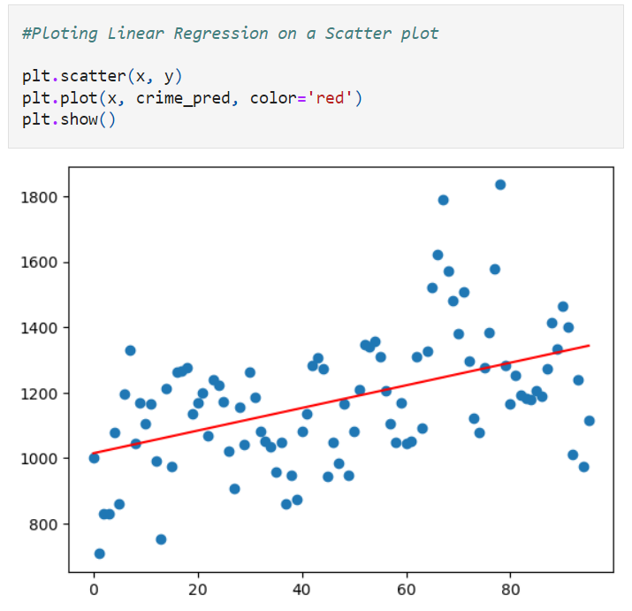
MACHINE LEARNING
TITLE
We are using a linear regression model to predict the frequency of violent crimes occurring per month.
R Score ?? OR CORRELATION ??
Total of Incidents per Month
JAN 2015
Midpoint
dec 2022
Data Timeline

Slide 6
VISUALIZATIONS
INTERACTIVE DASHBOARD

Slide 7
SUMMARY
Answers to our questions.

